Slide 1
Completion Object Overview
June 2013
WITSML/PRODML Standards

Slide 2
Completion Object Project
Started: May, 2011 with participation from both WITSML and PRODML
Participating companies: Chevron (sponsoring operator), Weatherford, Peloton, (lead vendors), Schlumberger, Paradigm, ExxonMobil, BP, Total, Halliburton with Energistics
Delivery for Special Interest Group and subsequent public review: January 2013.
After review, final version release: June 2013

Slide 3
Business Case and Benefits

Slide 4
High Level Application of Completion Object
Primary Initial Usage
Drilling – Production hand-offs
DB to DB sync & transfer
Initial completion & subsequent workovers
Initial Completion transfer from rig
Well services through life of asset
Engineering applications transfers
Eg, Nodal analysis models
Well surveillance

Slide 5

Primary Initial Use Case: Over the Well Lifecycle, Drilling & Production MUST Pass Data Back and Forth
Drilling & Completions Domain
Production Domain
Primary Initial Usage
Drilling system
WITSML
New Completion
Completion DB
Current
Workover Planned
Drilling Data
Completion Data
Now Enabled
Data Updates
Drilled
Well
As Completed
Well
Well Services
SSSV
DTS
E.g. Gas Lift
Change
Tubing
Perm.
Gauge
Packer
Perforations

Slide 6
Business Drivers and Benefits
Eliminate multiple data entry requirements thereby improving accuracy and saving time
Improved safety. Knowledge of what is down hole will improve operations
Improved data consistency, accuracy, quality
Improved planning and scheduling (through faster access to better quality data and by eliminating manual re-entry of data)
Reduce reliance on paper or spread sheet well files

Slide 7
Concepts for Completion Object

Slide 8
Three Use Cases dealt with in this release
Snapshot of completion at a point in time
“what is current status?” eg for completion diagram, engineering application eg Nodal
Change Log of events which alter completion between one time and another
Eg, from well services contractor
Cumulative History – whole life of well capable of generating current snapshot or any previous one
Eg, for sync or transfer between databases

Slide 9

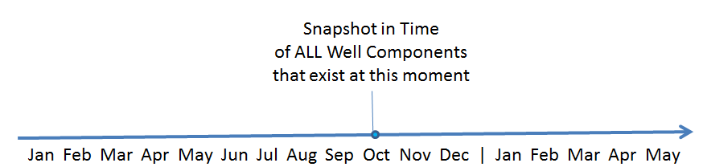
Example Snapshot at One Instant
Snapshot is akin to a completion diagram at one instant in time
SSSV
DTS
Tubing
Casing
Perm.
Gauge
Packer
Perforations

Slide 10
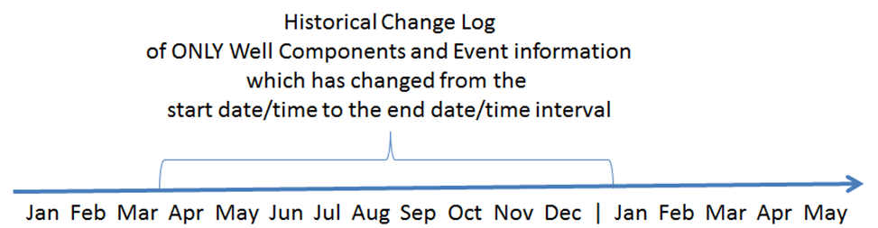
Example Change Log for Single Job
SSSV
DTS
SSSV
DTS
Tubing
Casing
Tubing
Casing
Perm.
Gauge
Perm.
Gauge
Packer
Packer
Perforations
Perforation Job
Well CM [Construction and Maintenance] Ledger entry
Perforations
Data concerning change, in Downhole Components

Slide 11
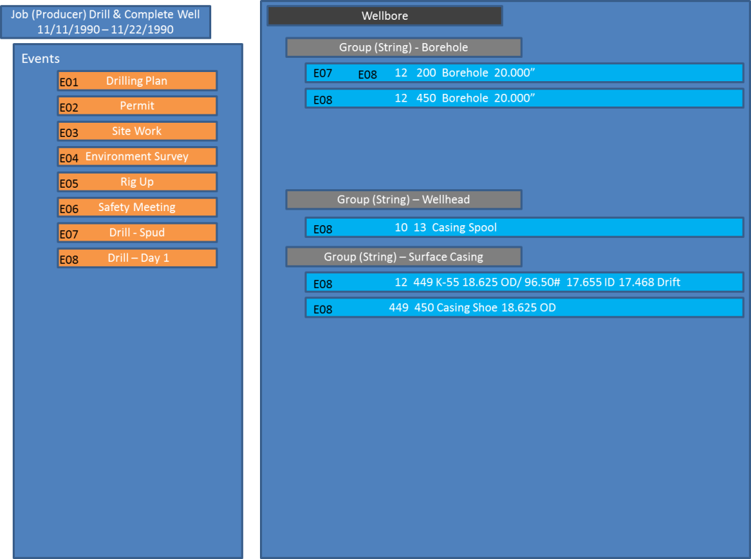
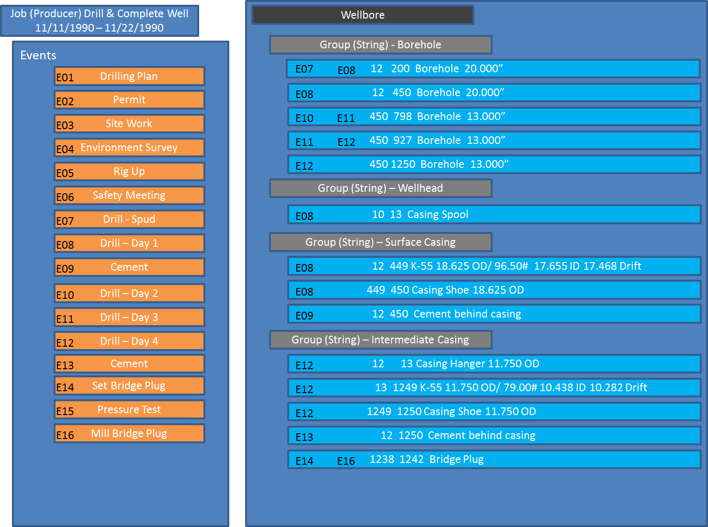
Example Well Cumulative History
Day 1
Day 4
Events
Well equipment
Well CM Ledger gets added to cumulatively
Downhole Components added, updated or removed by Events

Slide 12
Data Organization
4 top-level objects:
Downhole Component - contains wellbore equipment
Well Construction Management Ledger - contains details of Jobs & Events
Well Completion –associates a wellhead stream with one or more wellbore completions (completed zones) in the well
Wellbore Completion – represents a section of wellbore open to flow with reservoir.

Slide 13
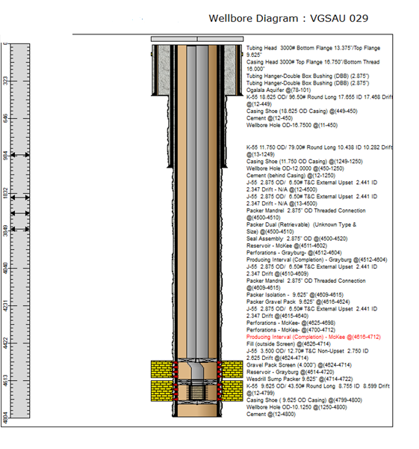
Scope of Downhole Components
Wellhead
Accessory
Wellhead: not described in full detail
Cement: placement as well as properties (also other fills)
Downhole String Set
Casings: multiple strings supported, can include joint tally
Accessories to strings: e.g. packers, gas lift valves
Tubings: multiple strings supported, can include joint tally
Borehole String Set
Borehole: the open hole sizes as drilled
Perforation Sets
Formation Layers: with basic properties
String Equipment
Perforation Set: physical description of perforations etc.
Equipment: the components used
Assembly: groups of components

Slide 14
Scope of Well Construction Management Ledger
Identity information such as the well name
Event Information, eg depth & time ranges of operation
Completion reference information including references to string, equipment.
Operational/management information eg, business associate, w/order number, cost, rig ID, flags if operation was planned/unplanned etc.
eventExtension - contains the job data (limited types), may have reference to details in a WITSML object
Participant – enables link to be made to any WITSML object, eg a log. No semantic meaning conveyed.

Slide 15
Nesting of Jobs containing multiple Events
An event in the ledger can have a parent event ID.
Events can be organized into a hierarchy.
Eg, “Job Producer” = top level event
“Sub Job” Events with this “Job Producer” parent:
“Job – Well Service Rig Crew”
“Job – Site Work”
“Job – Tubing Inspection”
From Different Service providers
Hence, each service provider can supply their report to operator using the data-object

Slide 16
Scope of Flow Paths, Reservoir to Wellhead
Parent =well
Parent =wellbore
Parent = downholeComponent
Well Completion: a commingled “flow” in the well, eg “X”
A References Well Completion X
Not Specified: flow through specific tubing strings etc
Wellbore Completion: section of borehole open to flow , eg “A”
Contains Contact Intervals
Contact Interval: physical connection to reservoir,
4 types: perf, o/h, slot, g/p
These would be further Wellbore Completions & Contact Intervals, linked to the 2nd tubing string’s Well Completion
References Perf set, borehole, equipment as appropriate
AND Geology feature
String Equipment: has
Ref’d Perforated Intervals: from this component (eg casing)
Perforation Set: physical perforation details

Slide 17
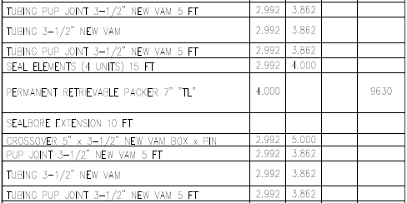
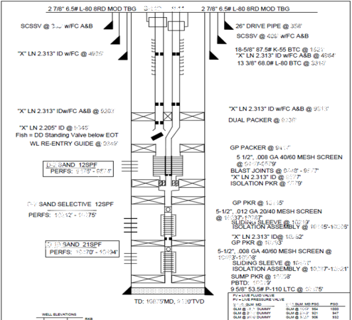
Role of Well and Wellbore in Completion
The whole completion spans multiple wellbores so Downhole Components has parent Well
Well Completion (where Well “flows” are defined has parent Well
String and Equipment have parent downhole component and are associated with a wellbore (the end (bottom) point will define which wellbore)
Each wellCMLedger entry in wellCMLedgers can apply to a different well (in addition to wellbore)
Borehole has parent downhole component and is associated with a wellbore
Wellbore Completion and Contact Interval has parent wellbore

Slide 18
Future Plans (Possible)
Surveillance, flow paths etc – where are instruments, flows reported & measured (PDGs, DTS, etc.)
in complex completions especially
Optimization – addition of inflow performance and description, fluid properties ➔ Nodal Analysis
Reservoir connection made explicit e.g. with link to RESQML layers
Tree and surface equipment
Further “xxxJob” objects, eg perfJob, gravelPackJob, which contain full details of operations (not just “end result” of the jobs)

Slide 19
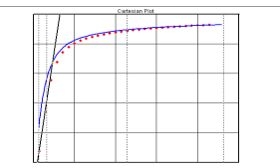
Other (secondary) Use Cases in Production Domain
Production Domain
Completion DB
Surveillance/
Reporting
Optimization
Optimization using Nodal models
Flowing
Intervals, sensor depths
DTS
Perm.
Gauge

Slide 20
Summary
A Major new Capability for life of well completion data management
Needs promotion and adoption now
Potential to Expand Data Coverage and Usage
Potential to support new “Well Services DOF” industry approach with standard services reporting method

